Slide 1
3.Phenomenology of Two Higgs Doublet Models

Slide 2
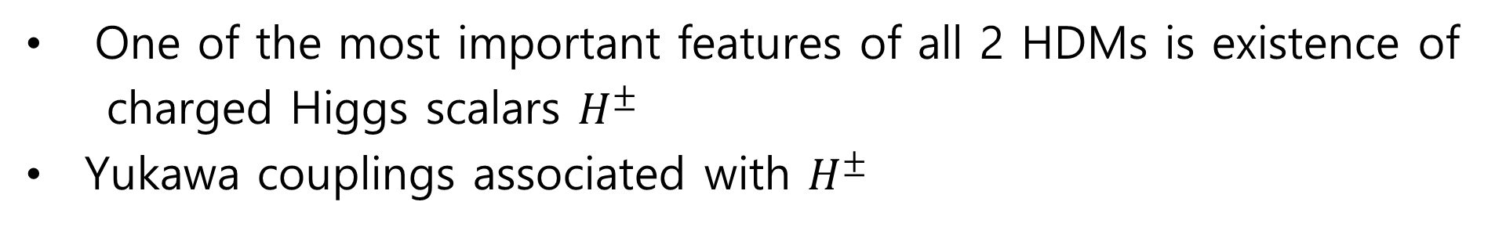
Charged Higgs Bosons
One of the most important features of all 2 HDMs is existence of
charged Higgs scalars $H^{±}$
Yukawa couplings associated with $H^{±}$

Slide 3
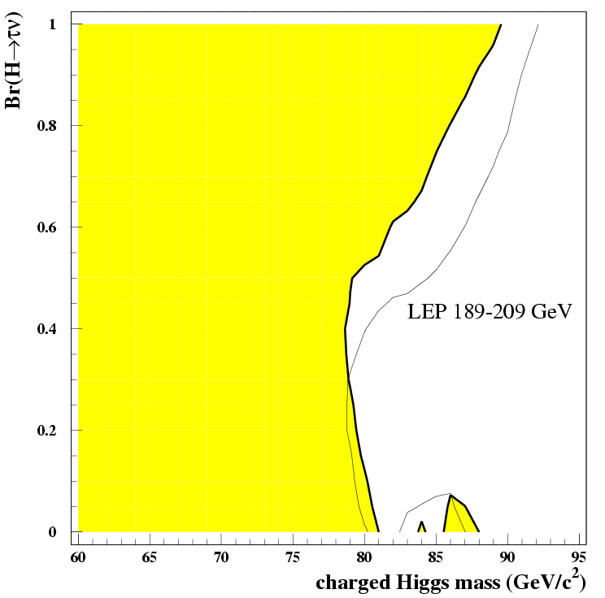
Singly charged Higgs mass limit from LEP:
Assumed decay channels
LEP Higgs working group, LHWG note 2001-05.

Slide 4
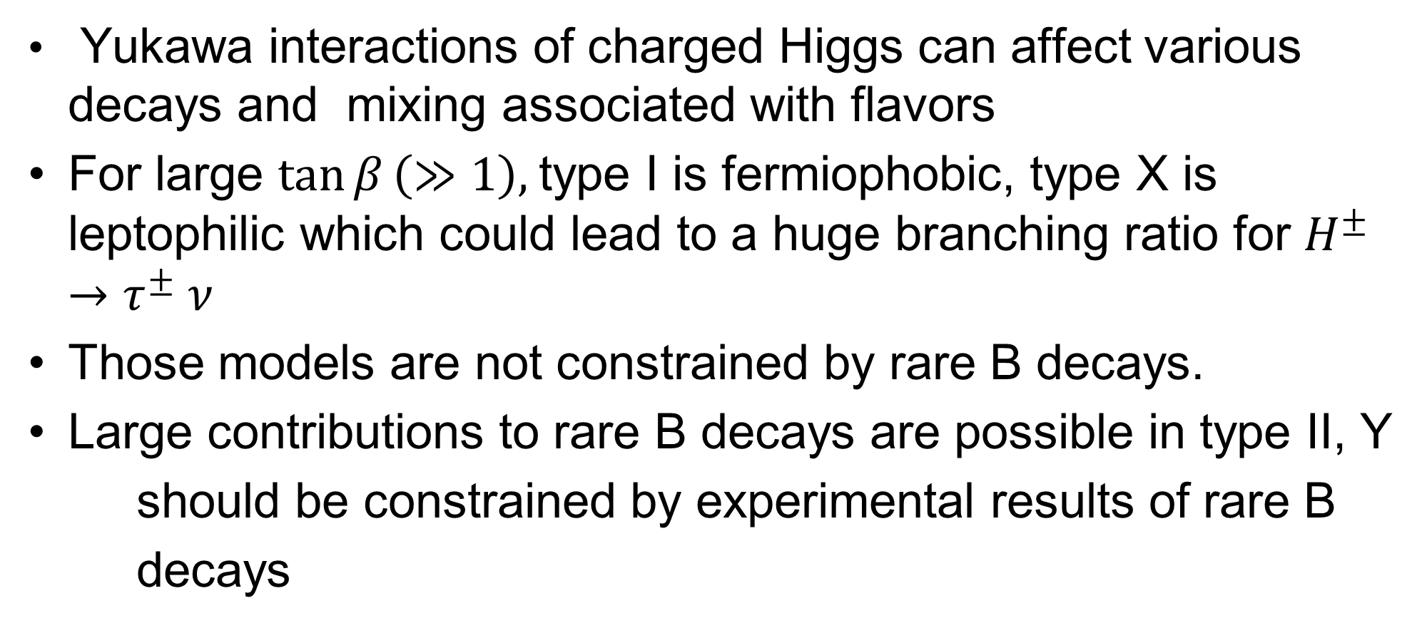
Constraints from Flavor Physics
Yukawa interactions of charged Higgs can affect various decays and mixing associated with flavors
For large $\tan{β}\left(≫1\right),$type I is fermiophobic, type X is leptophilic which could lead to a huge branching ratio for $H^{±}→τ^{±} ν$
Those models are not constrained by rare B decays.
Large contributions to rare B decays are possible in type II, Y
should be constrained by experimental results of rare B
decays

Slide 5
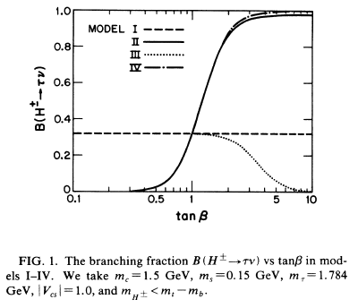
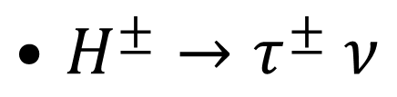
$H^{±}→τ^{±} ν$
Barger/Hewett/Phillips, 1990
The branching ratios can be very different from the SM.
tan β is important for phenomenology!
For processes which depend only on quark sector, models I and IV are similar, as well as models II and III.

Slide 6
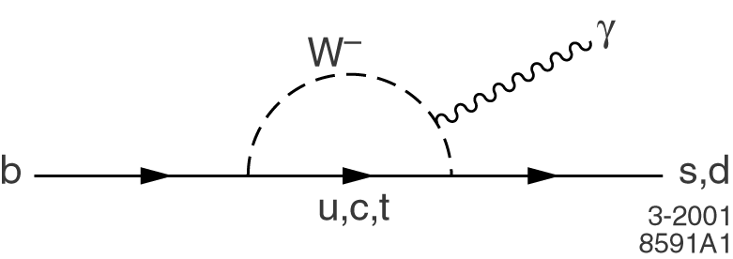
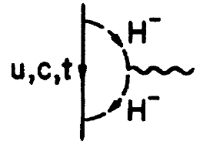
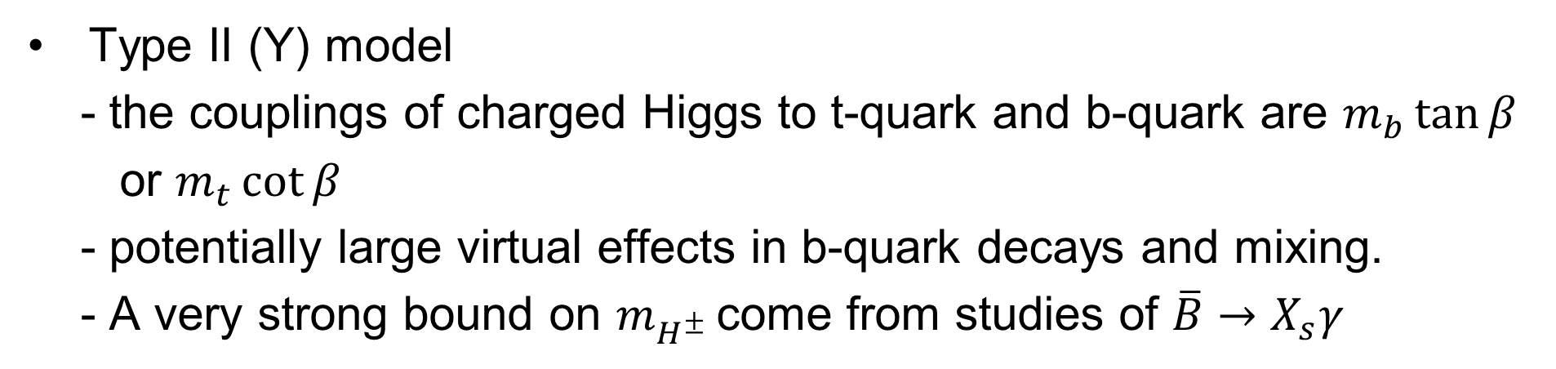

$\overline{B}→X_{s}γ$
Type II (Y) model
- the couplings of charged Higgs to t-quark and b-quark are $m_{b}\tan{β}$
or $m_{t}\cot{β}$
- potentially large virtual effects in b-quark decays and mixing.
- A very strong bound on $m_{H^{±} }$come from studies of $\overline{B}→X_{s}γ$
In model II the contribution is always bigger than in the SM, while in model I one can have strong cancellations due to –cot β in the coupling.

Slide 7
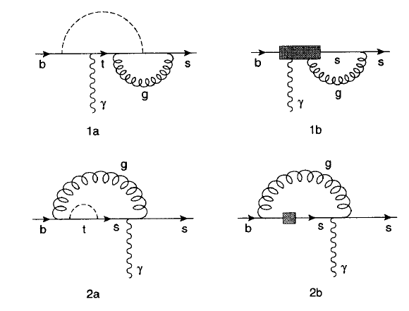
V
Full NLO QCD results
Uncertainty range of theoretical predictions (Ciuchini et al, 1998) is
such that mH+>250-300 or so GeV is required in type II

Slide 8
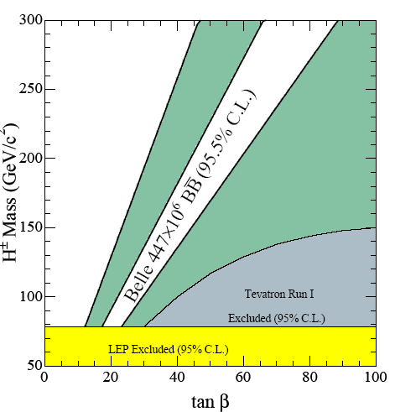
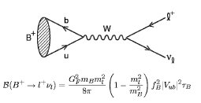
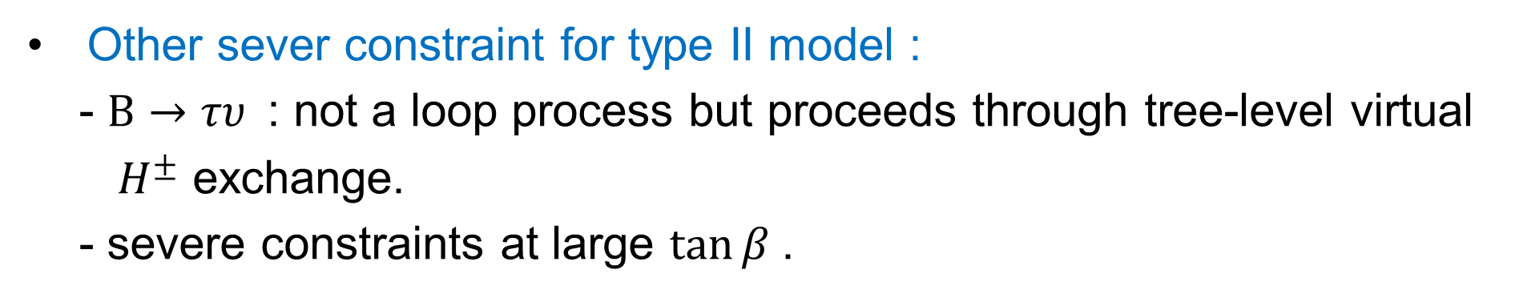

Other sever constraint for type II model :
- $B→τυ$: not a loop process but proceeds through tree-level virtual
$H^{±}$ exchange.
- severe constraints at large $\tan{β}$.
2006 ICHEP
$$=1.13±0.05$$

Slide 9
Crivelli et al.
arXiv:1303.5877

Slide 11
Bounds for type II model (Haisch ‘08)

Slide 12
Solid line : from
Bounds for type I model
(Branco et.al ‘11)
dashed line : from

Slide 13


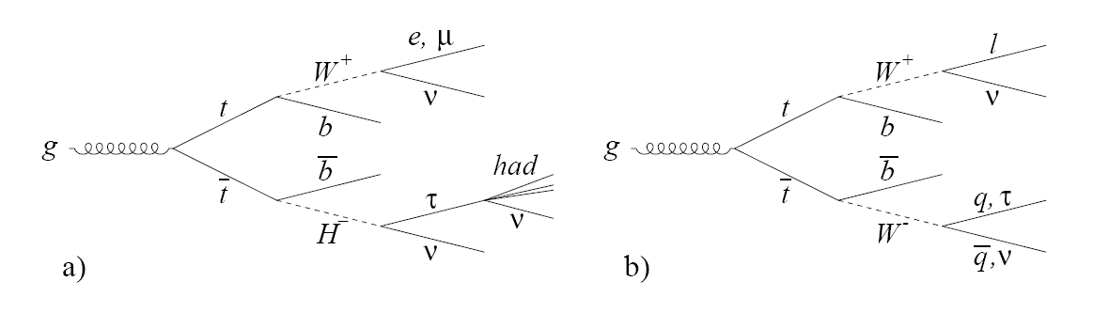
Productions of Charged Higgs
Light charged Higgs :
Top decay can produce light charged Higgs : t→ H± b
Constrained by
(Tevatron)
BR(t→H±b)~m_{top}² cot²β+m_{b}² tan²β
Production of light charged Higgs at the LHC :

Slide 14




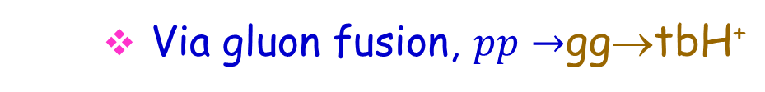
10⁸ top quarks produced
More than 10⁵ charged Higgs expected
Heavy charged Higgs production at the LHC
dominant channel :
Via gluon fusion, $pp→$gg→tbH⁺

Slide 15
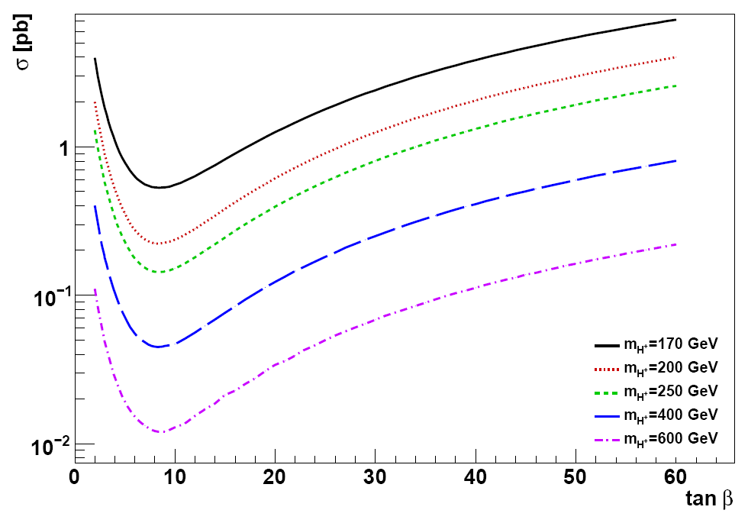
M. Flechl., ATLAS Collaboration, presented at Prospects for Charged Higgs Discovery at Hadron Collider, Uppsala, Sweden (2008)

Slide 16
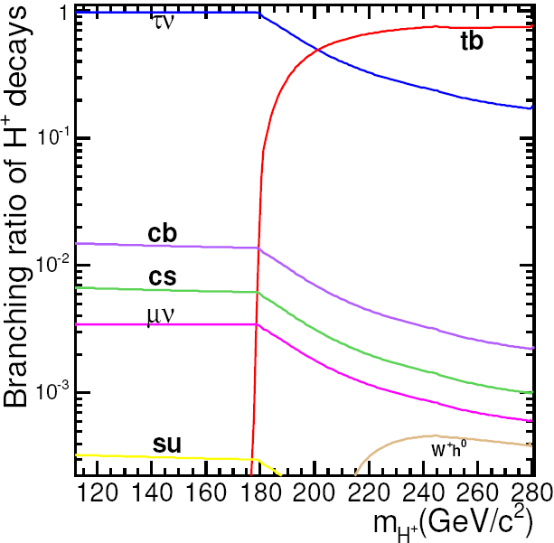
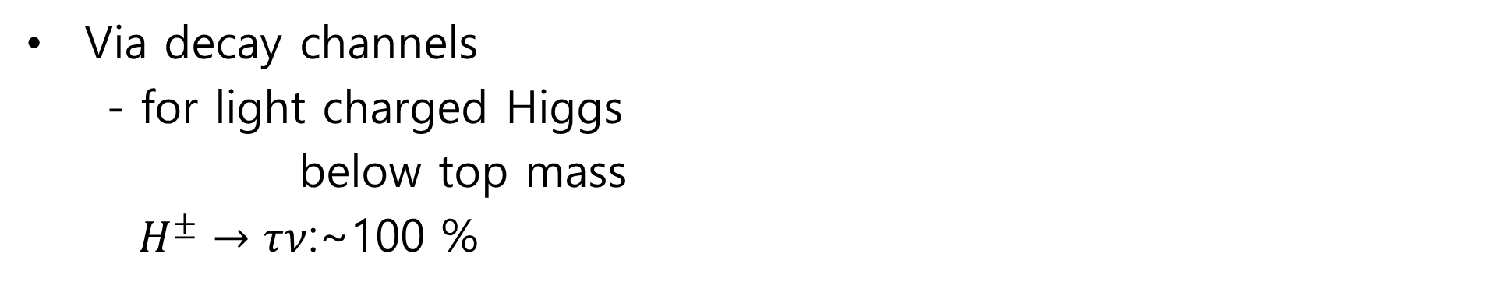
Search for light charged Higgs at the LHC
Via decay channels
- for light charged Higgs
below top mass
$H^{±}→τν$:~100 %
H⁺ Decay | W Decay
τυ,τ→had | qq
τυ,τ→had | lυ
τυ, τ→lep | qq
H± decay BR. into different final states for tan β = 20

Slide 17
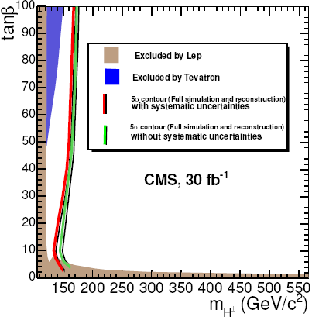
Discovery potential
CMS Note 2006/056

Slide 18
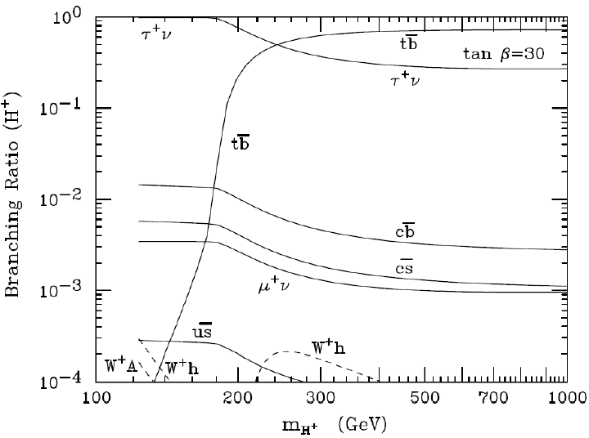
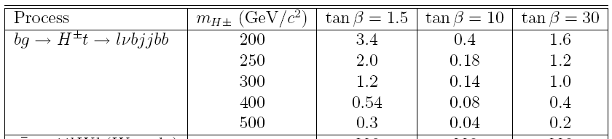
Search for heavy charged Higgs at the LHC
Above top mass:
- BR(H⁺→tb)~0.8-1
- H⁺→tb results in complex
final states :3 or 4 b jets
Crucial to supress very large kinematically similar ttbar+jets background
_{Channels of interest:}
_{σxBR (pb)}
H⁺ Decay | W Decay
τυ,τ→had | qq
tb | lυ & qq

Slide 19
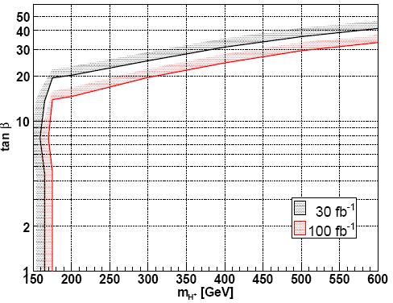
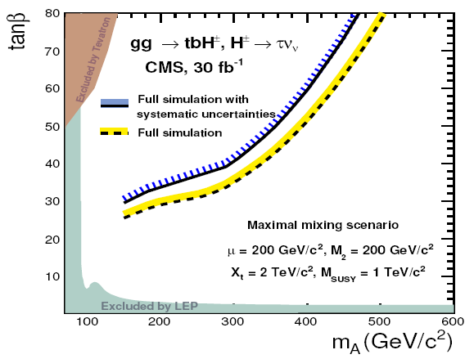
Discovery potential
ATLAS
CMS
with systematics
without systematics
systematics included
Background: Full simul.
without systematics
Background: FAST simul.
- promising channel for heavy charged Higgs

Slide 20
Search for neutral Higgs

Slide 21
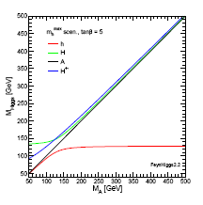
Mass spectrums
For M_{A}< 135 GeV (M_{h}^{max} scenario)
The ligth Higgs is SM-like
M_{A}≈ M_{h}
For M_{A}> 150 GeV (decoupling limit)
The heavy MSSM Higgs:
M_{A}≈ M_{H} ≈M_{H}±
Pythia 6.226
FeynHiggs2.2
S.G, H.Bilokon,V.Chiarella,G.Nicoletti
ATL-PHYS-PUB-2007-001
Sven Heinemeyer
Atlas meeting 29.01.2008
Pythia 6.226

Slide 22
Production of neutral Higgses
V*=W/Z
Main production mechanism ~SM
For high and moderate tanb the production with b quarks is enhanced
For m_{A} >>m_{Z} A/H behave very similar →decoupling region
A, H, H± cross section ~tanb²

Slide 23
Production Cross Section
At small tanb gg→h,H,A dominant
Vector boson fusion process
pp→qq→qq+WW/ZZ→qq+h/H
important at m _{h} ~ m _{hmax}
Higgsstrahlung neglegible
At high tanb associated b quarks
production dominates
pp → bb →h/H/A+ bb
Φ=h,H,A
Abdelhak Djouadi arXiv:hep-ph/0503173v2 (2005)

Slide 24

Branching Ratio for Neutral Higgs Decays
Decoupling region
M_{A}≥ 150 GeV tanb ≈30
or M_{A}≥ 400-500 GeV tanβ=3
Production rate
Decay bb dominates,
ττ lower background
weaker sensitivy on
SUSY parameters
Abdelhak Djouadi arXiv:hep-ph/0503173v2 (2005)

Slide 25
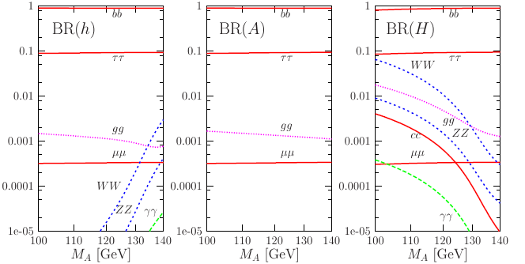
Branching Ratio for Neutral Higgs Decays
Intense coupling region tanb ≈30 M_{A}~ 120-140 GeV
Coupling to W,Z up quarks suppressed
Coupling down quark (b) and τ enhanced
Decay bb, ττ dominates
Decay μμ possible
Abdelhak Djouadi arXiv:hep-ph/0503173v2 (2005)

Slide 26
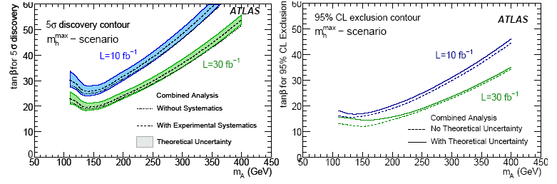

Discovery Potential
Signal cross section uncertainties 17%
Systematic experimental uncertainties based on detector expected performances:
e.g. muon efficiency, muon PT scale, muon resolution, Jet energy scale,
Jet energy resolution, btag efficiency, b-tagging fake rate.
Based on detector expected performance 10-20%
Large systematic uncertainties demand for
data-driven method background estimation
preliminary
Combined 0-b-jet and ≥1 b-jet analysis
preliminary

Slide 27

Pair Productions
Trilinear coupling can be large for Heavy Higgs
(Robert N. Hodgkinson )

Slide 28
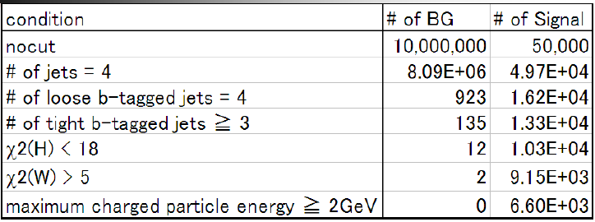

Pair Productions
``Feasibility study of Higgs pair creation in gamma-gamma collider’’ (Norizumi Maeda )
For measuring Higgs self coupling
Higgs mass =125 GeV
Optimized photon collision E = 270 GeV
(BR=0.43)
16 events/year → 4.6 sigma (10 years)

Slide 29
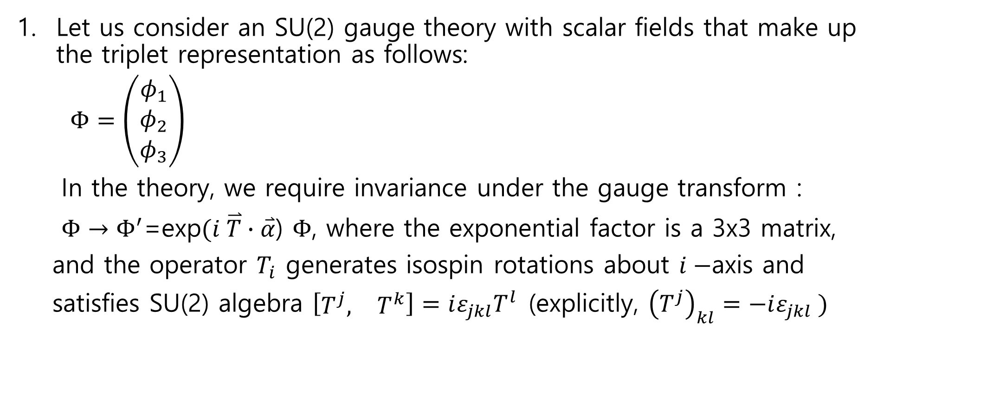
Project I
Let us consider an SU(2) gauge theory with scalar fields that make up the triplet representation as follows:
$Φ=\left(\begin{matrix}φ_{1} \\ φ_{2} \\ φ_{3}\end{matrix}\right)$
In the theory, we require invariance under the gauge transform :
$Φ→Φ^{′}$=exp$(i \overset{⃑}{T}∙\overset{⃑}{α}$) $Φ$, where the exponential factor is a 3x3 matrix,
and the operator $T_{i}$ generates isospin rotations about $i−$axis and
satisfies SU(2) algebra $\left[\begin{matrix}T^{j}, & T^{k}\end{matrix}\right]=iε_{jkl}T^{l}$(explicitly, ${\left(T^{j}\right)}_{kl}=−iε_{jkl} )$

Slide 30
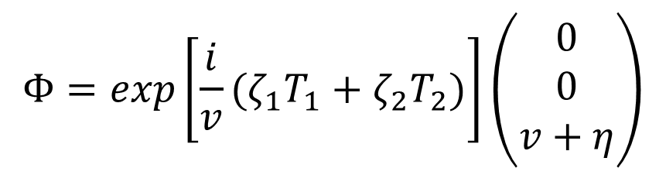
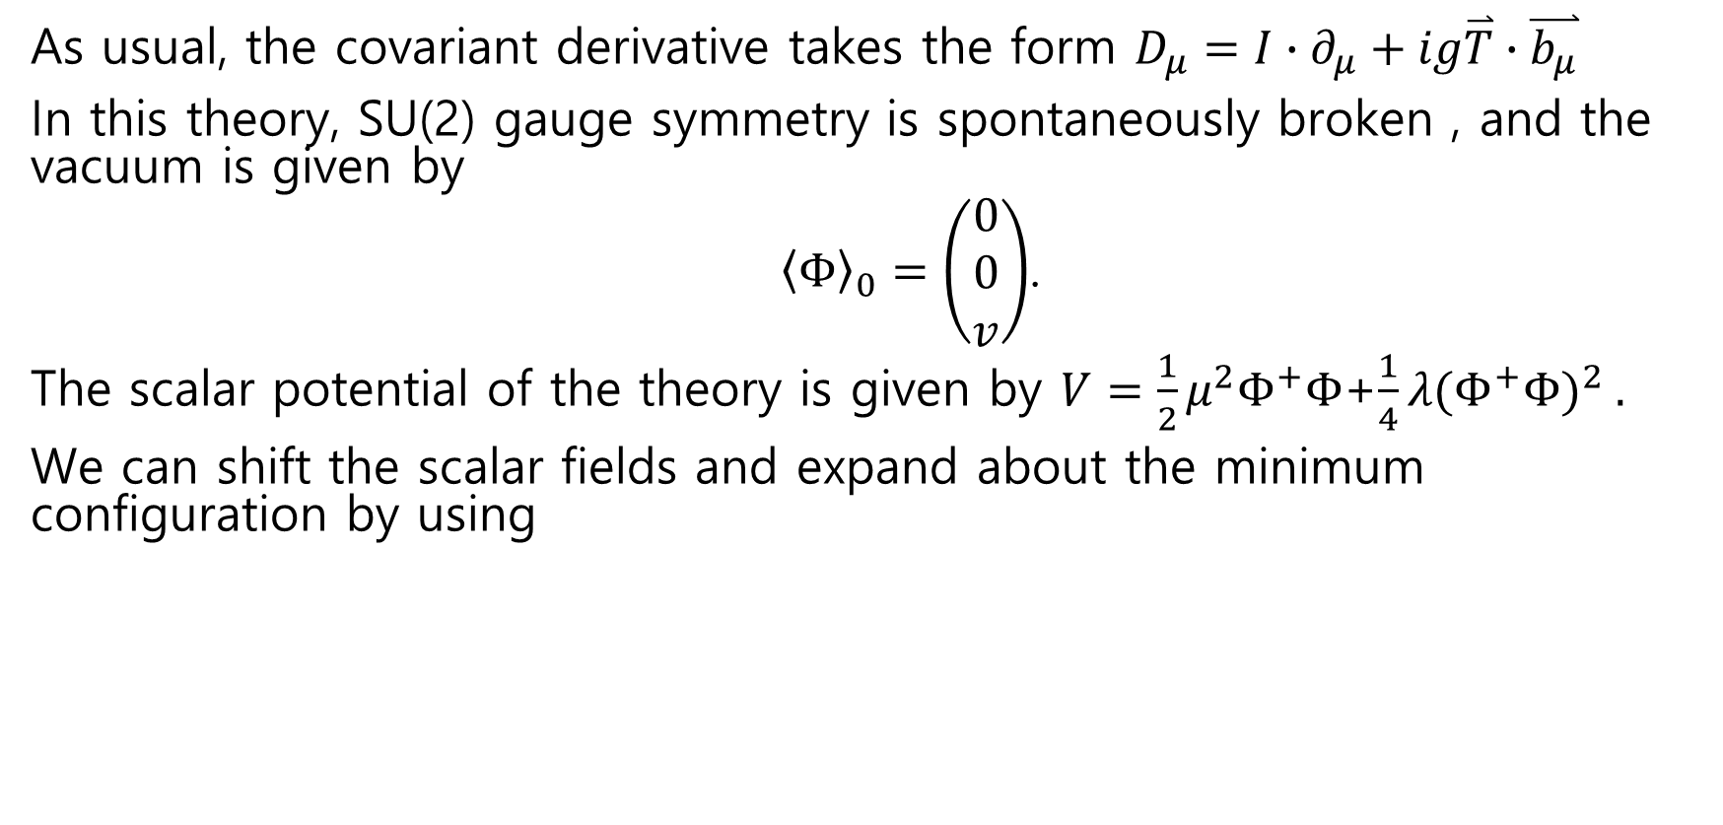
Project I
As usual, the covariant derivative takes the form $D_{μ}=I∙∂_{μ}+ig\overset{⃑}{T}∙\overset{⃑}{b_{μ}}$
In this theory, SU(2) gauge symmetry is spontaneously broken , and the vacuum is given by
${\left\langle Φ\right\rangle }_{0}=\left(\begin{matrix}0 \\ 0 \\ v\end{matrix}\right)$.
The scalar potential of the theory is given by $V=\frac{1}{2}μ^{2}Φ^{+}Φ$+$\frac{1}{4}λ(Φ^{+}Φ)^{2} .$
We can shift the scalar fields and expand about the minimum configuration by using
$$Φ=exp\left[\frac{i}{v}(ζ_{1}T_{1}+ζ_{2}T_{2})\right]\left(\begin{matrix}0 \\ 0 \\ v+η\end{matrix}\right)$$

Slide 31
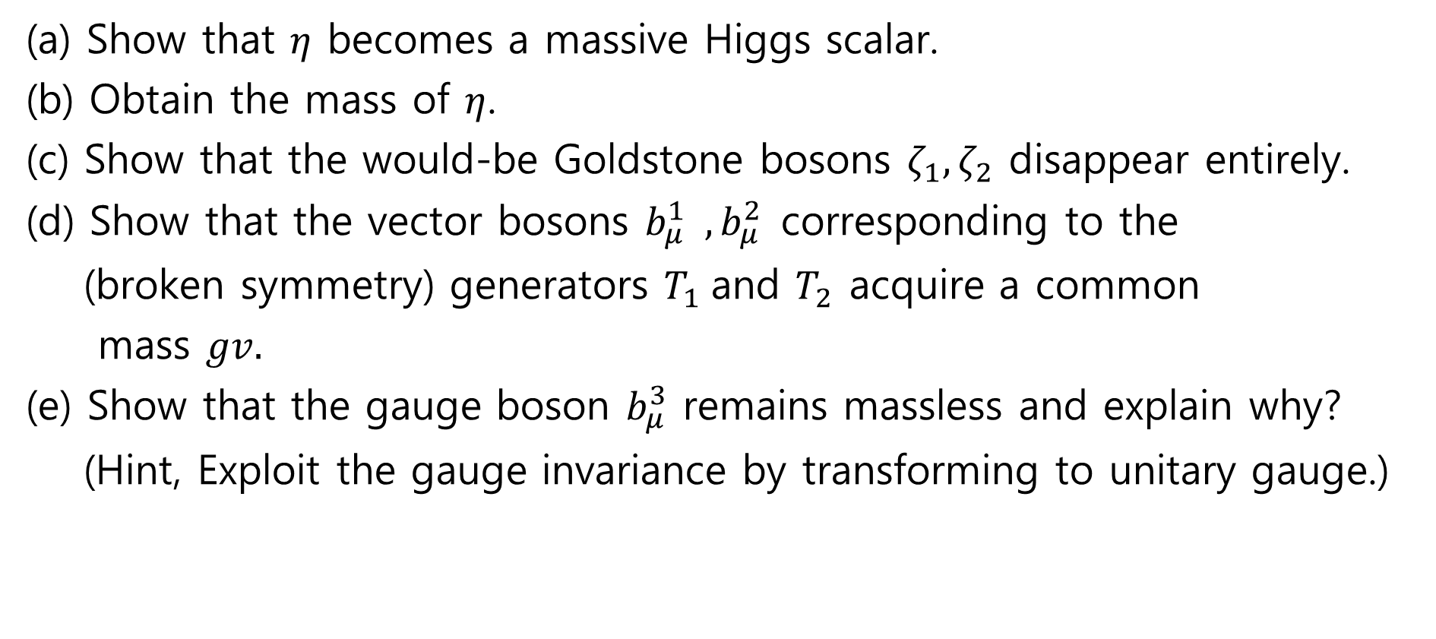
Project I
(a) Show that $η$ becomes a massive Higgs scalar.
(b) Obtain the mass of $η$.
(c) Show that the would-be Goldstone bosons $ζ_{1}, ζ_{2}$ disappear entirely.
(d) Show that the vector bosons $b_{μ}^{1} , b_{μ}^{2}$corresponding to the
(broken symmetry) generators $T_{1}$and $T_{2}$ acquire a common
mass $gv.$
(e) Show that the gauge boson $b_{μ}^{3}$ remains massless and explain why?
(Hint, Exploit the gauge invariance by transforming to unitary gauge.)

Slide 32
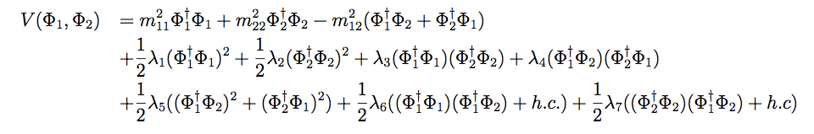

Project II
For the scalar potential of two Higgs doublet models given by
Derive the minimization conditions of V (taking $λ_{6}=λ_{7}=0)$.
Show that would-be Goldstones (three) are eaten by $W^{±}, Z$gauge bosons (i.e. disappear).
Obtain masses of 5 Higgs bosons (2 neutral CP even, 2 charged and a CP-odd).

