Slide 1
2. Two Higgs Doublets Model

Slide 2
Motivations to study 2HDM
No fundamental principle for SM Higgs boson
2HDM has been studied theoretically, as well as limited experimentally, in great detail because:
It’s a minimal extension of the SM higgs sector.
It satisfies both experimental constraints we mentioned.
It gives rich phenomenology due to additional scalar bosons.

Slide 3
Motivations to study 2HDM
New physics often requires extended Higgs sectors
(e.g.)
- B-L gauge, Dark matter scenario,.. : SM Higgs + S (singlet scalar)
- MSSM, Dark Matter, Radiative Seesaw…: SM Higgs + Doublet
- LR model, type-II seesaw … : SM Higgs + Triplet
Higgs sector can be a probe of New Physics

Slide 4
Structure of 2HDM

Slide 5
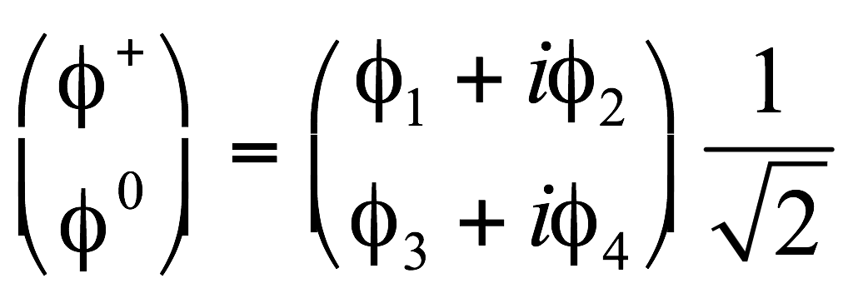
Higgs Field in SM
Standard Model assumes the simplest choice for the Higgs field:
a complex doublet with Y = 1.
Complex for U(1)
Doublet for SU(2)
Y=1 to make quantum numbers come out right.
- The superscript indicate the charge according to: Q = T³ + Y/2

Slide 6
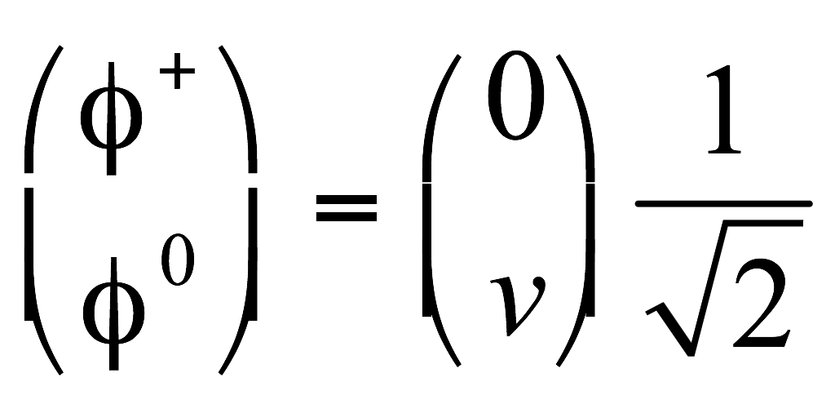
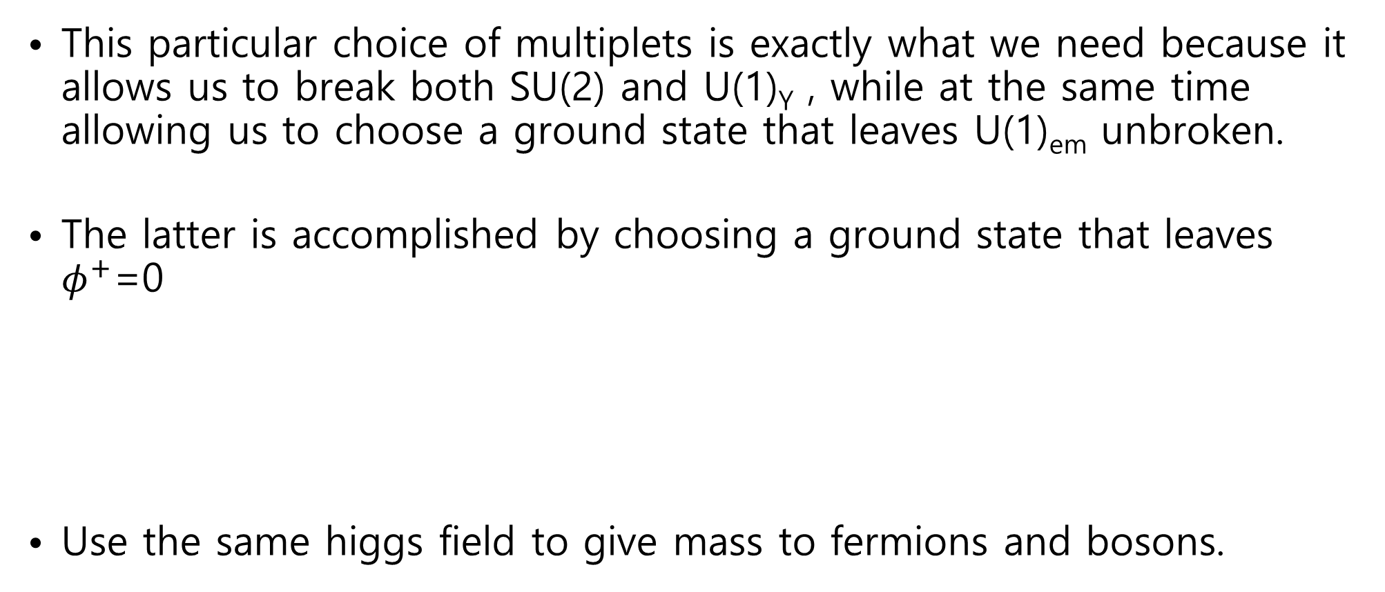
Higgs Ground State in SM
This particular choice of multiplets is exactly what we need because it allows us to break both SU(2) and U(1)_{Y} , while at the same time allowing us to choose a ground state that leaves U(1)_{em} unbroken.
The latter is accomplished by choosing a ground state that leaves $φ^{+}$=0
Use the same higgs field to give mass to fermions and bosons.

Slide 7
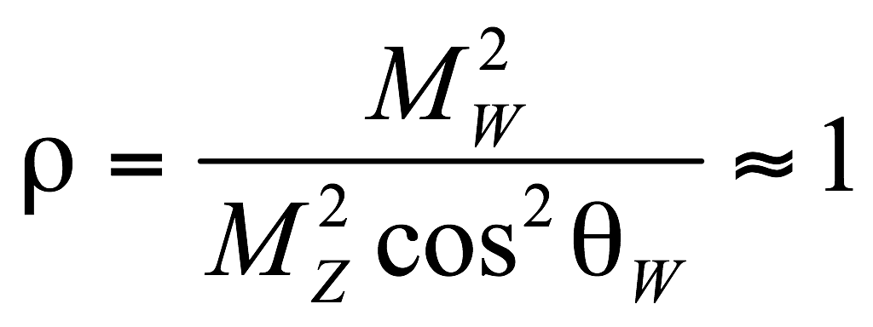
Extended Higgs Fields
There are in principle many choices one could make.
Constraints to be satisfied :
- the Higgs fields belongs to some multiplet of SU(2) x U(1).
- Unitarity should not be violated at large s.
- there are experimental constraints, the most stringent of which
are:
-FCNC are heavily suppressed in nature.

Slide 8
Electroweak ρ parameter is experimentally close to 1
constraints on Higgs representations
ρ=1 (2T+1)²-3Y²=1.
Thus doublets can be added without problems with ρ.
For the other representations, one has to finetune the VEVs to produce ρ=1. This may be motivated from other considerations.

Slide 9
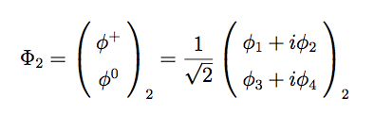
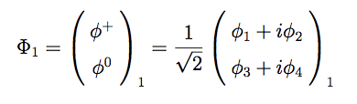


Two Higgs Doublets
Lagrangian :
Yukawa terms :

Slide 10

Flavor Changing Neutral Current
No observation of FCNC constrains the model.
When two Higgs doublets acquire different VEVs, the mass terms read,
Diagonalization of the mass matrix will not give diagonal Yukawa couplings will induce large, usually unacceptable Tree-level FCNC in the Higgs sector.

Slide 11
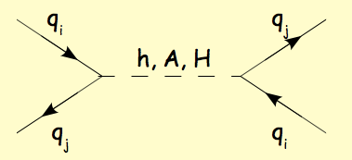
Flavor changing neutral currents at the tree level, mediated by the Higgs bosons
No loop suppression of the four fermion operators!
(e.g.) $\overline{d}$s$h$ term leads to tree-level $K−\overline{K}$ mixing !

Slide 12
Paschos-Glashow-Weinberg theorem (77’, PRD15)
- All fermions with the same quantum numbers couple to the same Higgs multiplets, then FCNC will be absent.

Slide 13

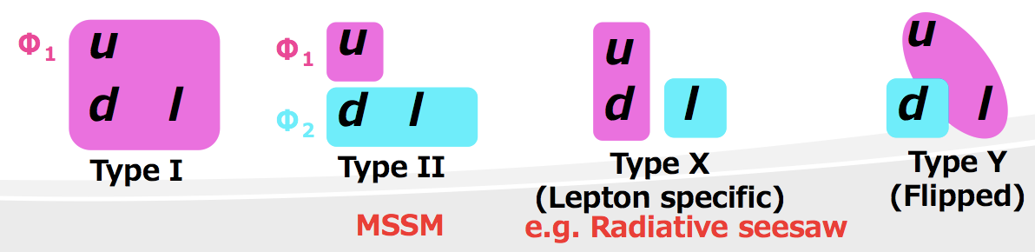
To avoid FCNCs, Φ₁ and Φ₂ should have different quantum numbers with each other.
Easiest way is to impose Z₂ symmetry
4 types of Yukawa Interactions are possible :

Slide 14
4 typical 2HDMs by discrete symmetry

Slide 15
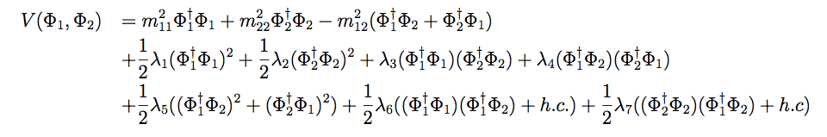


Higgs Potential
Let’s consider CP conserving case.
CPC —> all parameters, vacuum expectation values are real.
Z2 symmetry requires
But, we can avoid FCNC while keeping

Slide 16
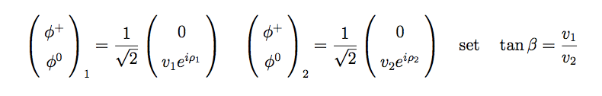



Vacuums
Conditions for stable vacuums (taking )

Slide 17
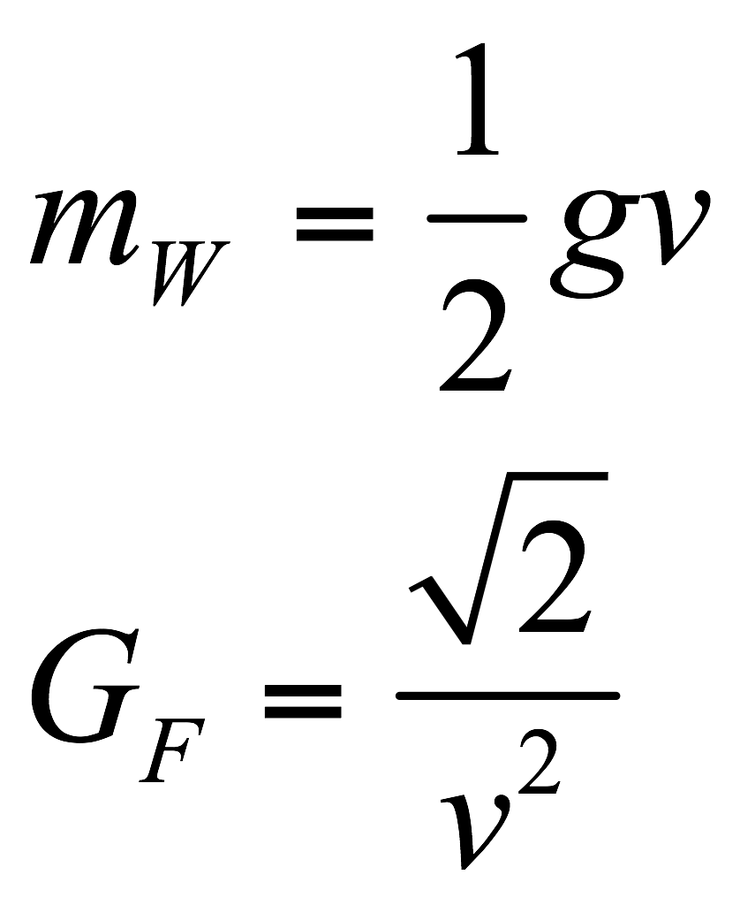
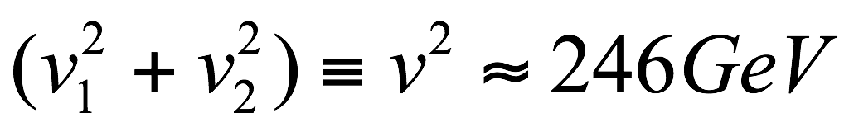
For Standard Model
For 2HDM this stays the same, except for:

Slide 18
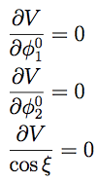


Checking if the vacuums defined above is true vacuum.
Performing minimization of the scalar potential

Slide 19




condition for spontaneous CP violation:
and
if the parameters of the scalar potential are real and if there is no
spontaneous CP-violation, then it is always possible to choose the
phase so that the potential minimum corresponds to ξ = 0.

Slide 20
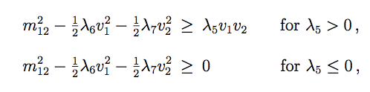
condition for CP conserving vacuums:

Slide 21
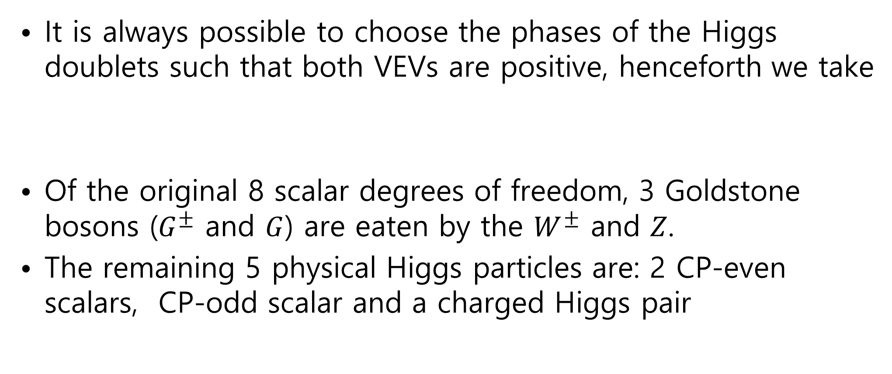
Higgs Boson Spectroscopy
It is always possible to choose the phases of the Higgs doublets such that both VEVs are positive, henceforth we take
Of the original 8 scalar degrees of freedom, 3 Goldstone bosons ($G^{±}$ and $G$) are eaten by the $W^{±}$ and $Z$.
The remaining 5 physical Higgs particles are: 2 CP-even scalars, CP-odd scalar and a charged Higgs pair

Slide 22


Higgs Boson Spectroscopy
One CP-odd neutral Higgs with squared-mass:
Two charged Higgs with squared-mass:
And two CP-even Higgs that mix.

Slide 23
Physical mass eigenstates :
Diagonalization of the above squared-mass matrix

Slide 24
Masses and Mixing α :
Physical Higgses and Goldstone bosons :

Slide 25
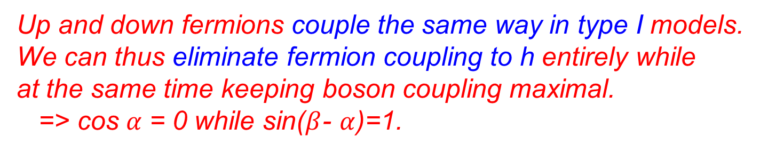
Coupling Constants
Yukawa Interactions
Up and down fermions couple the same way in type I models.
We can thus eliminate fermion coupling to h entirely while
at the same time keeping boson coupling maximal.
=> cos $α$ = 0 while sin($β$- $α$)=1.

Slide 26
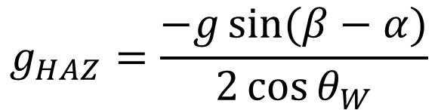
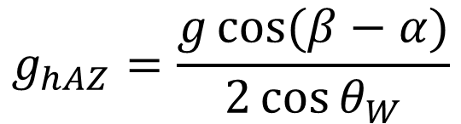
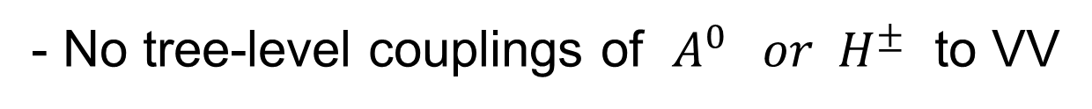
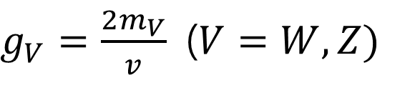
Gauge Interactions
- The Higgs couplings to gauge bosons are model independent !
$$g_{hVV}=g_{V}m_{V}\sin\left(β−α\right)$$
$g_{V}=\frac{2m_{V}}{v}$($V=W,Z)$
$$g_{HVV}=g_{V}m_{V}\cos{(β−α)}$$
- No tree-level couplings of $A^{0} or H^{±}$ to VV
- Trilinear couplings of one Gauge boson to 2 Higgs bosons
$$g_{hAZ}=\frac{g\cos{(β−α)}}{2\cos{θ_{W}}}$$
$$g_{HAZ}=\frac{−g\sin{(β−α)}}{2\cos{θ_{W}}}$$

Slide 27
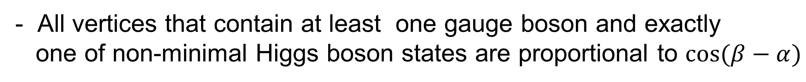
- Couplings of h and H to gauge boson pairs or vector-scalar bosons
- All vertices that contain at least one gauge boson and exactly
one of non-minimal Higgs boson states are proportional to $\cos{(β−α)}$

Slide 28
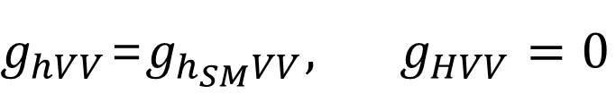
Decoupling Limit :
- All heavy particles are decoupled (integrated out) and thus the
theory effectively looks the standard model
$$\sin\left(β−α\right)=1, \cos\left(β−α\right)=0$$
$g_{hVV}$=$g_{h_{SM}VV}, g_{HVV}=0$
- Interactions proportional to $\cos\left(β−α\right)$ vanish

Slide 29
- Higgs spectrum

Slide 30
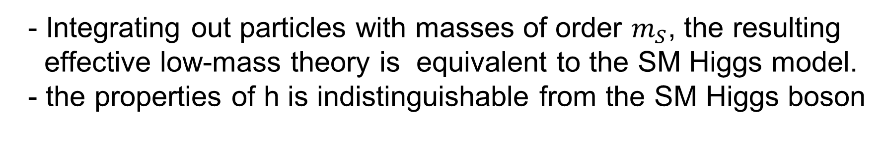
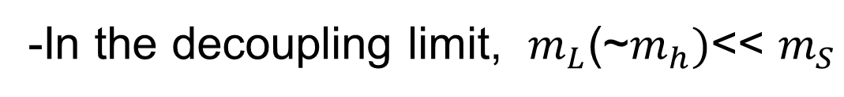
-In the decoupling limit, $m_{L}$(~$m_{h})$<< $m_{S}$
- Integrating out particles with masses of order $m_{S}$, the resulting
effective low-mass theory is equivalent to the SM Higgs model.
- the properties of h is indistinguishable from the SM Higgs boson

Slide 31
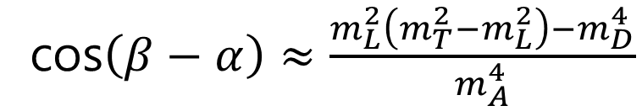
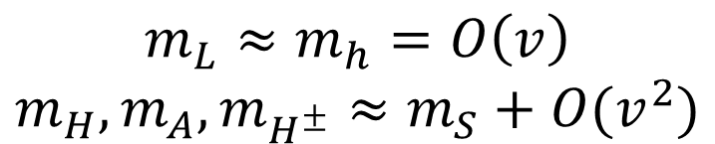
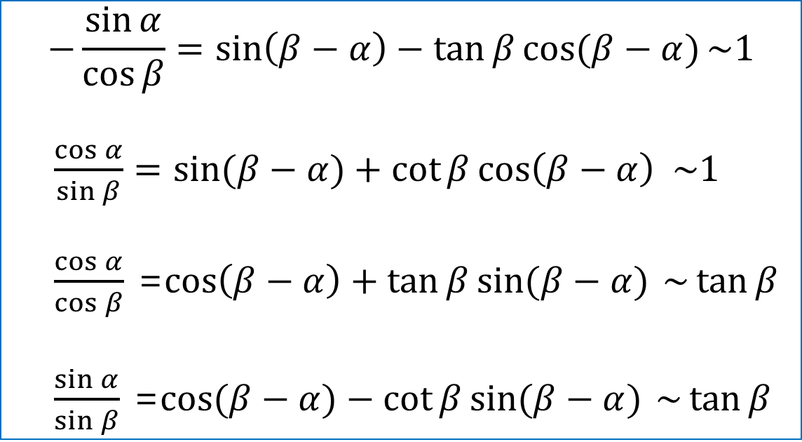
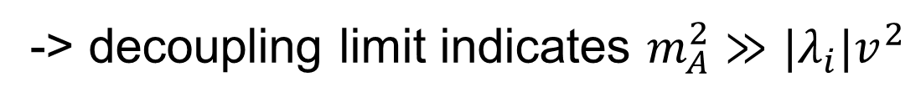
$$m_{L}≈m_{h}=O\left(v\right)$$
$$m_{H}, m_{A}, m_{H^{±}}≈m_{S}+O(v^{2})$$
cos$\left(β−α\right)≈\frac{m_{L}^{2}\left(m_{T}^{2}−m_{L}^{2}\right)−m_{D}^{4}}{m_{A}^{4}}$
-> decoupling limit indicates $m_{A}^{2}≫|λ_{i}|v^{2}$
$$−\frac{\sin{α}}{\cos{β}}=\sin\left(β−α\right)−\tan{β}\cos{(β−α)}\sim 1$$
$\frac{\cos{α}}{\sin{β}}=\sin{(β−α)}+\cot{β}\cos\left(β−α\right) \sim 1$
$\frac{\cos{α}}{\cos{β}}$ =$\cos\left(β−α\right)+\tan{β}\sin{(β−α)}$ $\sim \tan{β}$
$\frac{\sin{α}}{\sin{β}}$ =$\cos{(β−α)}−\cot{β}\sin{(β−α)}$ $\sim \tan{β}$
- Yukawa interactions :

Slide 32
Can decoupling limit be a mechanism for suppressed FCNC ?

Slide 33
- Rotating fermion fields :
- Diagonal mass matrices:

Slide 35
- Yukawa Couplings of h:
We see that h-mediated FCNC and CPV interactions are suppressed
in the decoupling limit.
FCNC and CPV effects mediated by A and H are suppressed by the
large squared-masses.

Slide 36
- If either $\tan{β}≫1 or \cot{β}≫1,$decoupling occurs when

Slide 37
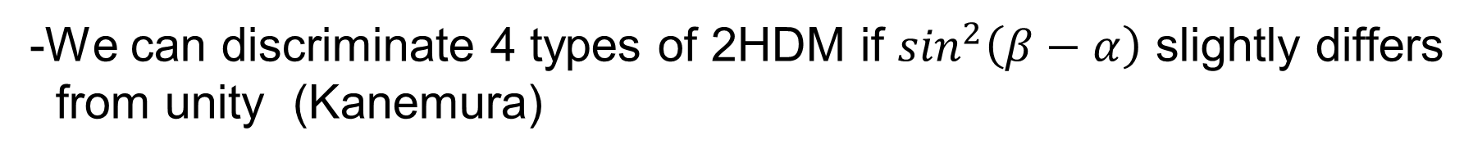
Can we discriminate 4 types of 2 HDM ?
-We can discriminate 4 types of 2HDM if $\sin^{2}\left(β−α\right)$ slightly differs
from unity (Kanemura)

Slide 38
(Kanemura)

