Slide 1
I. Brief History of Higgs Mechanism & Standard Model

Slide 2
Implications of Finding a Higgs Boson
It help us to understand the big universal question,
what are we made out of ?
It allows us to understand how the particles acquire mass.
We found the missing piece in the standard model.
It helps us to explain how two of the fundamental forces of the universe, the electromagnetic force and the weak force can be unified.
It opens the door ro new calculations that weren’t previously possible, including one that suggests the universe is in for a cataclysm billions of years from now.

Slide 3
Implications of Finding a Higgs Boson
It’s a crossroads in science
It allows physicists to try to go where no scientist has gone before
It could lead to unexpected everyday applications
It helps answer basic questions about how the universe evolved
It could change how physics is taught in high school
It’s proof that long, hard work can pay off.

Slide 4
Why do we need Higgs boson ?
Quantum electrodynamics works fine without a Higgs boson but the ’weak interactions’ do not.
Fermi developed a theory of weak interaction to describe radioactive decay with a dimensionful coupling G_{F}
Fermi theory is non-renormalizable and thus not fundamental.

Slide 5
Why do we need Higgs boson ?
A very important step toward weak interaction was the discovery that the weak four-fermion interactions involved V and A rather than S, T or P.
V–A theory proposed by Marshak & Sudarshan (1957) and by Feynman & Gell-Mann (1958)
This meant that the weak interactions could be seen as due to the exchange of spin-1 W± bosons. This made them seem very similar to electromagnetic interactions mediated by photons.

Slide 6
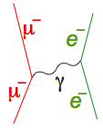
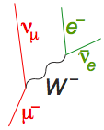
Similarity and Dissimilarity
Electromagnetic interaction
Weak interaction
exchange of
spin-1 γ
exchange of
spin-1 W±
But
long range
short range
large
parity conserving
parity violating
So: Can there be a symmetry relating γ and W±?

Slide 7
Early Unified Models
The first suggestion of a gauge theory of weak interactions mediated by W⁺ and W– was by Schwinger (1956), who suggested there might be an underlying unified theory, incorporating also the photon.
Glashow (1961) proposed a model with symmetry group SU(2) x U(1) and a fourth gauge boson Z⁰, showing that the parity problem could be solved by a mixing between the two neutral gauge bosons.
Salam and Ward (1964), unaware of Glashow’s work, proposed a similar model, also based on SU(2) x U(1)
— though neither model used the correct representation of leptons.
But gauge bosons are naturally massless, and in all these models symmetry breaking, giving the W bosons masses, had to be inserted by hand.
•

Slide 9
Massive vector bosons
• Gauge theories naturally predicted massless vector bosons.
• If masses were added by an explicit symmetry-breaking term, then
the vector-meson propagator would not be
But rather
• It generates a much worse divergence, and the theory is clearly not renormalizable.
• So the question started to be asked: could the symmetry breaking that gives rise to vector boson masses be spontaneous symmetry breaking?

Slide 10
Broken symmetries
Spontaneous breaking of gauge symmetry, giving mass to the plasmon, was known in superconductivity.
Nambu (1960) suggested a similar mechanism could give masses to elementary particles.
Nambu and Jona-Lasinio (1961) proposed a specific model
— phase symmetry is exact
— chiral symmetry is spontaneously broken

Slide 11
Spontaneous Symmetry Breaking
Spontaneous breaking of symmetry occurs when the ground state or vacuum state does not share the symmetry of the underlying theory.
It is ubiquitous in condensed matter physics
Often there is a high-temperature symmetric phase, and a critical temperature below which the symmetry is spontaneously broken
— crystallization of a liquid breaks rotational symmetry
— so does Curie-point transition in a ferromagnet
— gauge symmetry is broken in a superconductor
• Could this work in particle physics too?
Particle physics exhibited many approximate symmetries
— it was natural to ask whether they could be spontaneously broken

Slide 12
Nambu-Goldstone bosons
• But there was a big problem in Spontaneous Symmetry Breaking—
Goldstone theorem:
spontaneous beaking of a continuous symmetry implies the existence of massless spin-0 bosons,none of which had ever been seen.
• e.g. Goldstone model
— vacuum breaks symmetry:
— choose
and set
cubic and quartic terms
So (Goldstone boson)

Slide 13
Nambu-Goldstone bosons
• This was believed inevitable in a relativistic theory
(Goldstone, Salam & Weinberg 1962).
• Other models with explicit symmetry breaking were clearly divergent,
giving infinite results
No observed massless scalars no spontaneous breaking of a continuous symmetry !
How is the Goldstone theorem avoided ?

Slide 14
Higgs mechanism
In 1964, Englert & Brout , Higgs , Guralnik, Hagen & TK found that
The argument fails in the case of a gauge theory, e.g. in Coulomb-gauge QED, commutators do not vanish at spacelike separation.
Higgs model (gauged Goldstone model):
again set
cubic terms ...
Thus the massless gauge and Goldstone bosons have combined to give a massive gauge boson.

Slide 15
Electroweak (Standard) Model
• The electroweak model of Weinberg and Salam was basically Glashow’s SU(2) x U(1) model together with a doublet of Higgs fields interacting with leptons.
— gauge fields:
— Higgs fields: complex doublet, four real fields
— three give masses to , fourth is physical Higgs
— leptons form left-handed doublet
— and a right-handed singlet

Slide 16
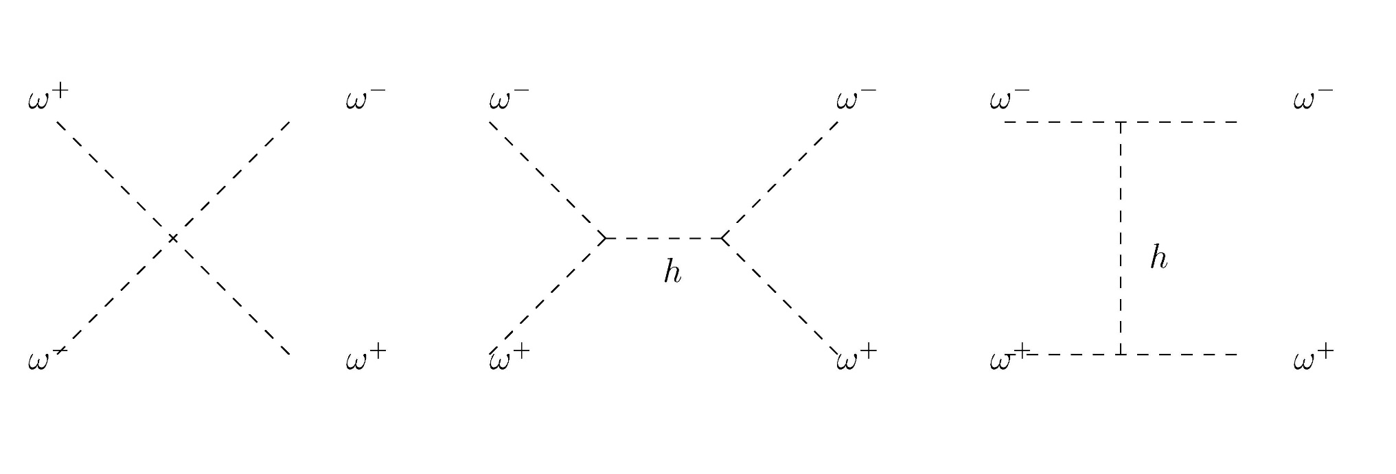
SM & WW scattering
Without the higgs, we get M ∝ s / m_{W}² for large s, and unitarity of scattering amplitude is violated!

Slide 17
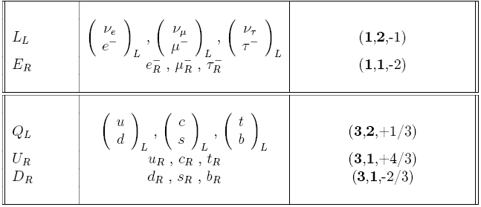
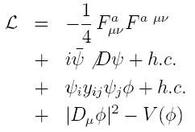
Summary of the Standard Model
Particles and SU(3) × SU(2) × U(1) quantum numbers:
Lagrangian: gauge interactions
matter fermions
Yukawa interactions
Higgs potential
Notes:
17

Slide 18
2. Higgs Boson

Slide 19
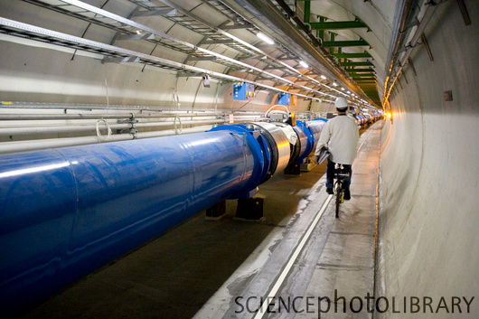
The Higgs boson
But after 1983 it started to assume a key importance as the only missing piece of the standard-model jigsaw.
The standard model worked so well that the boson (or something else doing the same job) more or less had to be present.
• Finding the Higgs was one of the main
objectives of the LHC.

Slide 20
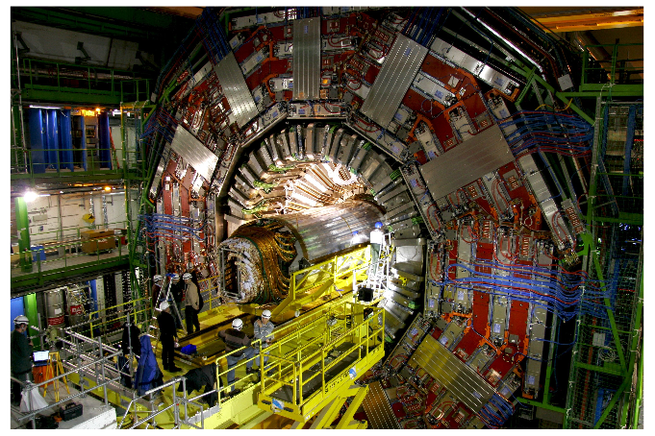
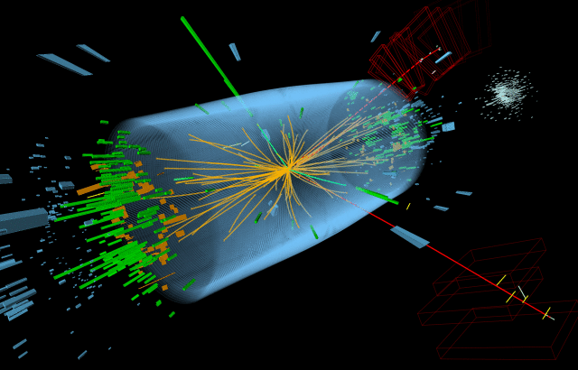
Discovery of the Higgs boson
• Two great collaborations, Atlas and CMS have over a 20-year period designed built and operated marvellous detectors.
CMS under construction
Possible Higgs event
• Result: almost certain discovery of the Higgs (of some kind)

Slide 21
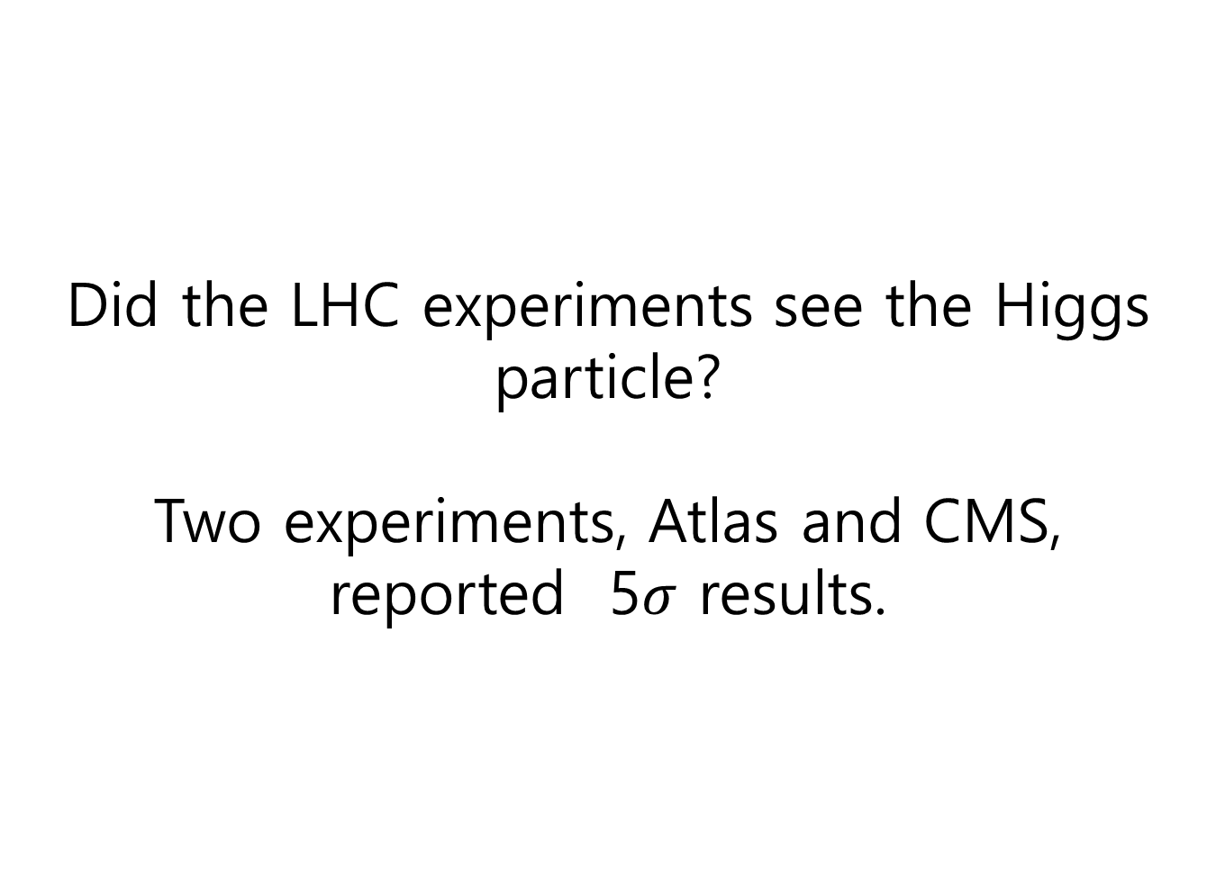
Did the LHC experiments see the Higgs particle?
Two experiments, Atlas and CMS, reported 5$σ$ results.

Slide 22
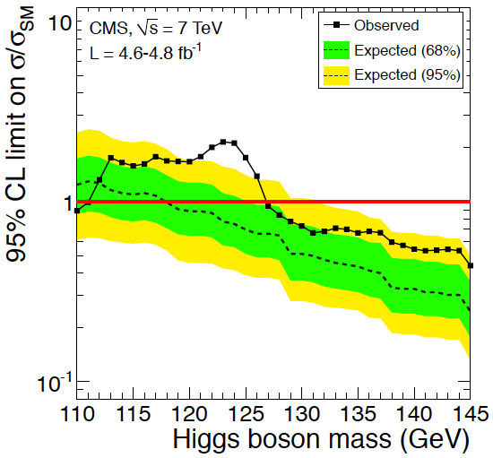
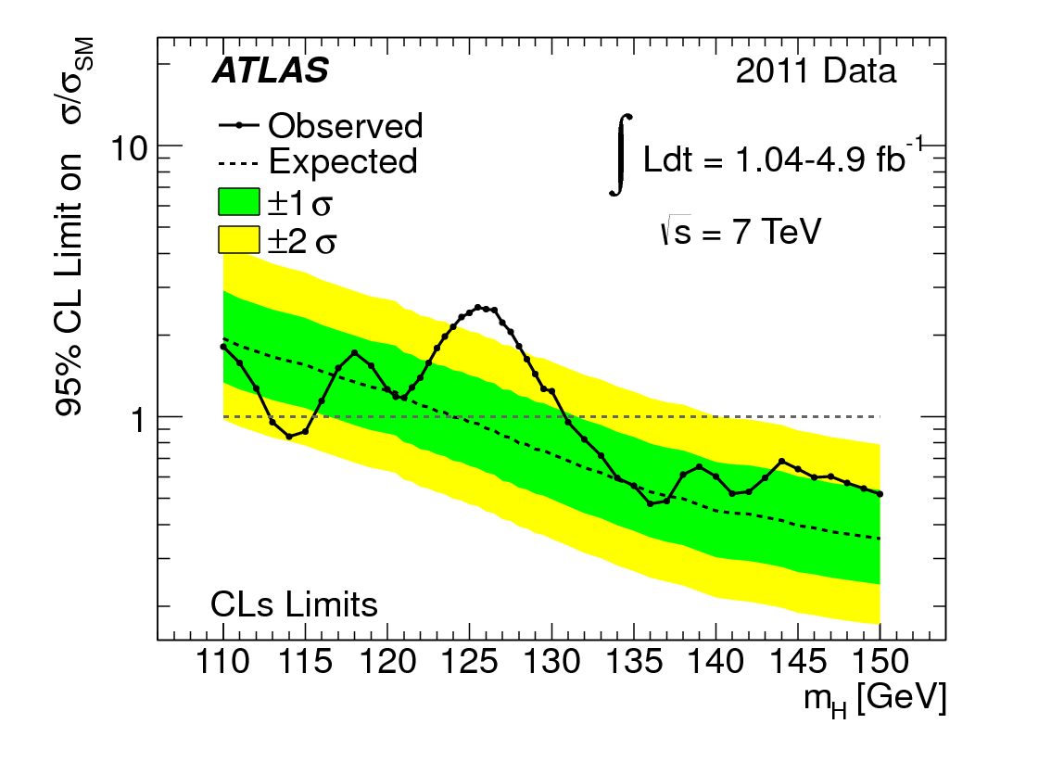
Has the Higgs been Discovered?
Interesting hints around M_{h} = 125 GeV ?
ATLAS prefers
125 GeV
CMS sees broad
enhancement

Slide 24
Is it really the Higgs?
• The evidence for a particle at around 125 GeV is now very strong, but is it the standard-model Higgs?
There is still a lot of work to do in the next few months
— we know it is a boson of even spin, but is it definitely 0, not 2?
— we know it decays into the expected channels, but are the
branching ratios those predicted by the standard model?
— there are some hints of possible discrepancies
• I think it is almost surely some sort of Higgs, but there are other possibilities beyond the standard-model Higgs

Slide 25
Is this the end of particle physics?
• Definitely No! There are many outstanding questions still to be answered.
• The standard model is wonderfully successful, but it is a mess
— it has something like 20 arbitrary parameters whose values we
cannot predict, e.g. ratios of particle masses, or why 3 generations
— it is not a unified model, being based on the symmetry group
SU(3) x SU(2) x U(1), with three independent coupling strengths
• There are suggestions that all three interactions become truly unified at an energy scale of about 10¹⁵ GeV
— one of the reasons for favouring supersymmetry is that this grand
unification idea works much better in a supersymmetric extension
of the standard model.

